Slide 1
Classification of finger movement from eeg
Sikender shahid & arian ehteshami University of Houston Cullen college of engineering

Slide 2
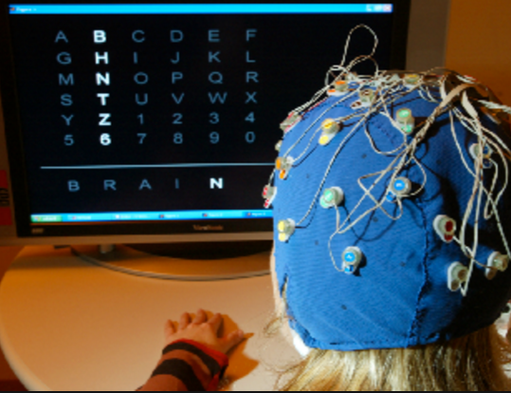
Motivation
The list of possible applications of BCI is practically endless
It ranges from simple decision programs to manipulation of the environment.
It also proves to be useful in artificial limb control, artificial leg control, artificial vision, artificial hearing sensation, and much more.

Slide 3
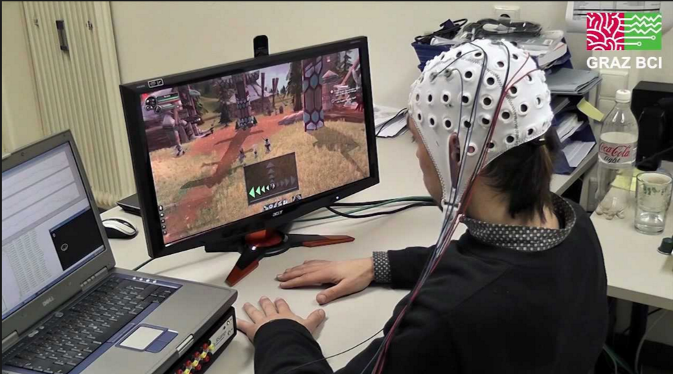
Background
BCI is a communication system where communications between the brain and the environment does not happen through the normal pathways.
The implication of this field is vast. It allows the computer to read signals from an array of neurons and translates the signal into an action through software.

Slide 4
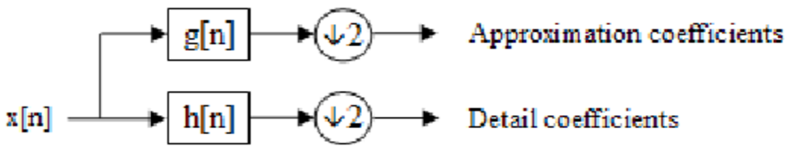
Methods/Algorithm
To successfully classify the test signal, the training data was first decomposed down to sub bands by the DWT. Because of the desired frequencies, a 5th level decomposition was implemented.
Alpha band ~= 7 – 15 [Hz]
Beta band ~= 15-32 [Hz]
Each subband corresponds to a detail coefficient which was used to reconstruct the filtered signal.

Slide 5
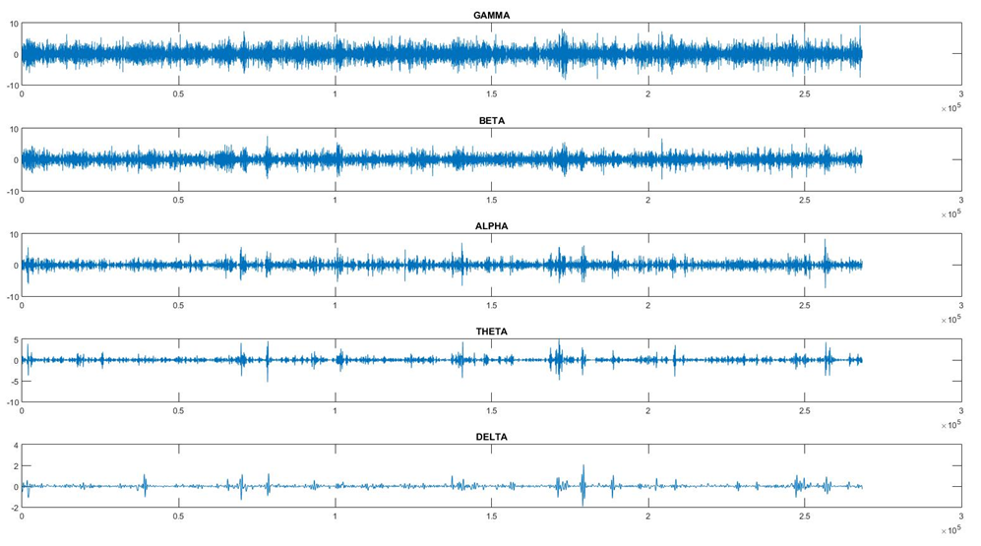
Preprocessing
Fs = 250 [Hz]
Range:
Fs/n = 30-60 [Hz]
Range:
Fs/n = 15 – 30 [Hz]
Range:
Fs/n = 7 – 15 [Hz]
Range:
Fs/n = 3 – 7 [Hz]
Range:
Fs/n = 0.5 – 3 [Hz}
Sub-Bands from Channel 1 which represents C3 electrode

Slide 6
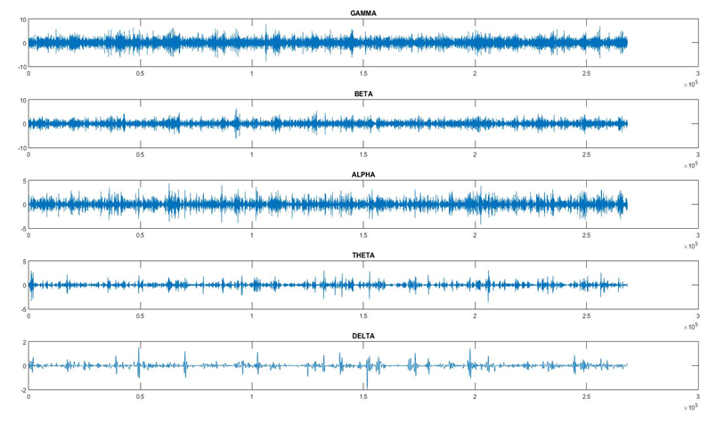
Preprocessing
Fs = 250 [Hz]
Range:
Fs/n = 30 – 60 [Hz}
Range:
Fs/n = 15 – 30 [Hz]
Range:
Fs/n = 7 -15 [Hz]
Range:
Fs/n = 3 – 7 [Hz]
Range:
Fs/n = 0.5 – 3 [Hz]
Sub-Band waveforms for the C4 electrode

Slide 7
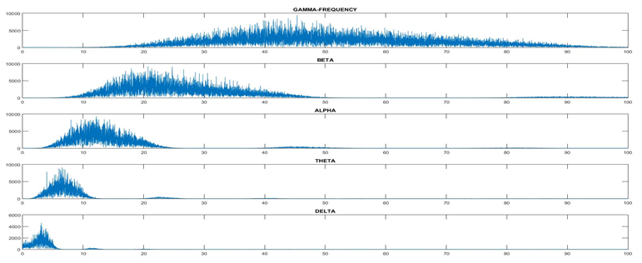
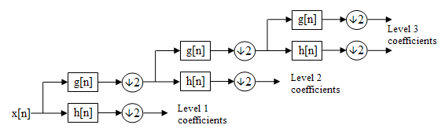
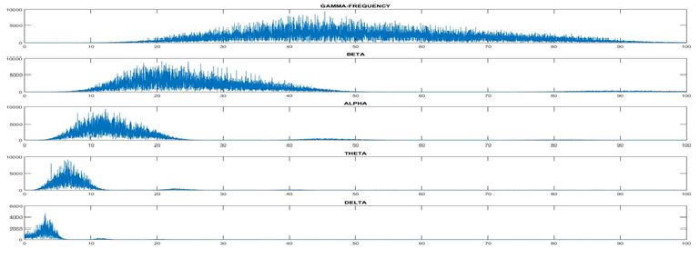
Sub-Band frequency distribution for electrode C3(top) and C4(bottom)

Slide 8

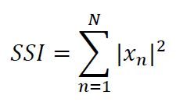
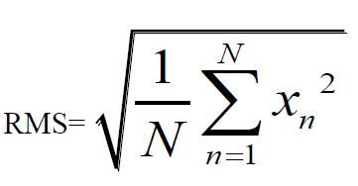
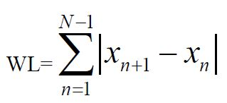
Feature Extraction
Modified Moving Average 2:
This feature is essentially calculating
the average of the absolute value of
the signal.
Simple Square Integral:
SSI uses the energy of the signal
As a feature.
Root Mean Squared
Waveform Length: WL is the
cumulative length of the waveform
over the segment

Slide 9
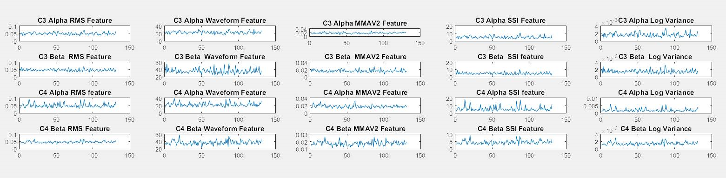
Organization and extraction of features

Slide 10
LDA Algorithm
1.
Class Matrix
Single matrix contain all classes
2.
Compactness Matrix – Scatter_between
Scatterness Matrix – Scatter_within
3.
Eigen Value Eigen Vector sorting
Dimensionality Reduction

Slide 11
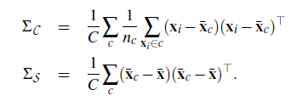


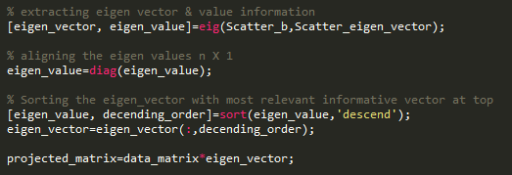
LDA Algorithm
Relational property

Slide 12
Results
Classes | Train_C3 | Train_C4 | Test_C3 | Test_C4
Actual 1 | 66 | 66 | 60 | 60
Actual -1 | 65 | 65 | 66 | 66
Predicted 1 | 45 | 48 | 44 | 41
Predicted -1 | 37 | 44 | 26 | 45
Percent Error 1 | 31% | 27% | 26% | 31%
Percent Error -1 | 43% | 32% | 60% | 31%
False 1 | 28 | 17 | 40 | 21
False -1 | 21 | 18 | 16 | 19

Slide 13
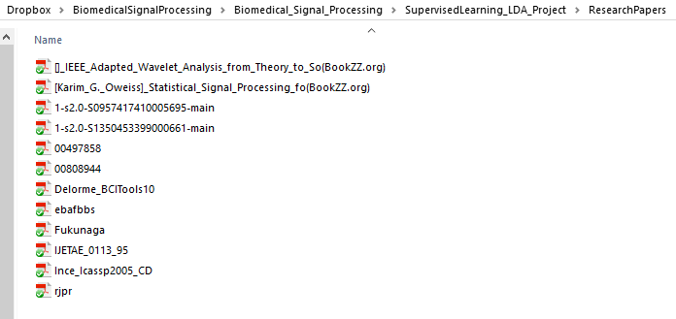
References

Slide 14
Questions?

